Slide 1



Introduction to the Deep Learning
Winter School
on
Deep Learning for Vision and Language Modelling
Organized by
Multimedia Lab, Department of Computer Science and Engineering
Indian Institute of Technology Guwahati
Arijit Sur
January 7, 2025

Slide 2
Multimedia Lab
Introduction

Slide 3
Multimedia Lab: Head of the Group ARIJIT SUR
Experience:
Current Position: Professor, Dept. of CSE, IIT Guwahati, from May 2022
Associate professor, Dept. of CSE, IIT Guwahati, from June 2016 to May 2022
Assistant Professor, Dept. of CSE, IIT Guwahati, from June 2009 to April 2016
Academics:
Ph D: Dept. of CSE, IIT Kharagpur, 2010
Title: Image Steganography: Various Approaches to Resist Steganalytic Attacks
M.Tech. : University of Calcutta, 2003

Slide 4
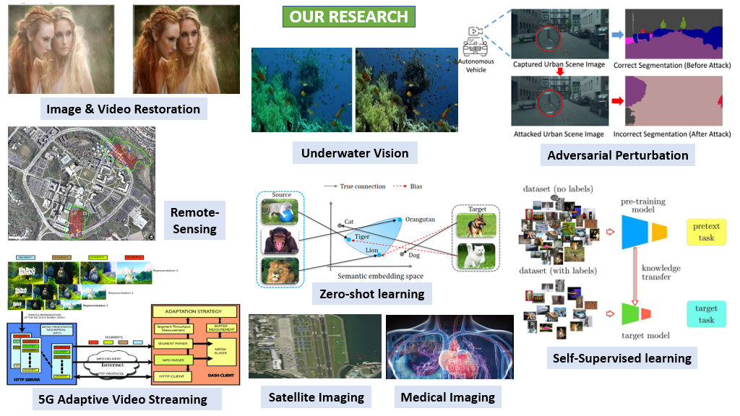

Slide 5









Our Group: Current Postdoc and PhD Students
Sandipan Sharma
Research Area:
Zero Shot Learning
Alik Pramanick
Research Area: Image Restoration
Sampriti Soor
Research Area: Generative AI
IPDF
Ashok Bandyopadhyay
Research Area: Visual SLAM (Part Time : ISRO)
Akashy Daydar
Research Area: Medical Imaging
Sonal Kumar Jha
Research Area: Semi Supervised Learning
Suklav Ghosh,
Research Area: Computer Vison
Utkarsh Srivastava
Research Area: Underwater Vision
Udit Sharma
Research Area: Robotic Vision

Slide 6
Our Group: Graduated Ph. D. Students
Prasen K Sharma (2022), Research Scientist at TensorTour Inc.
Brijesh Singh (2021), Technical Lead | R&D Functions & Algorithm Development Engineer at ZF Technology Centere India
Sathisha B (2020), Postdoc, University of Surrey, UK
Sibaji Gaj (2018), Postdoc, Cleveland Clinic, Ohio, USA.
Satish Kumar (2018), Research Fellow, 5G Innovation Centre, University of Surrey, Guildford.
Shuvendu Rana (2017), Postdoc, University of Strathclyde, Glasgow, UK.
Nilkanta Sahu (2016), Assistant Professor, Indian Institute of Information Technology Guwahati.
Tanima Dutta (2014), (Assistant Professor, Indian Institute of Technology, Varanasi (BHU))

Slide 7
Our Group:
Current Students and Project Staff
Current Ph. D. students: 8
Current M. Tech. Students : 4 + 2 MTP (DS)
Current B. Tech. Students : 6 + 3 BTP Minor
Project Staff: 1

Slide 8
Publications
30 Journals including
IEEE Transaction, ACM Transaction, Elsevier and Springer Journals
50+ International Conference including
WACV, BMVC, ICIP, EUSIPCO, ICDCN, ICVGIP, MMSP, DICTA, SMC etc.

Slide 9
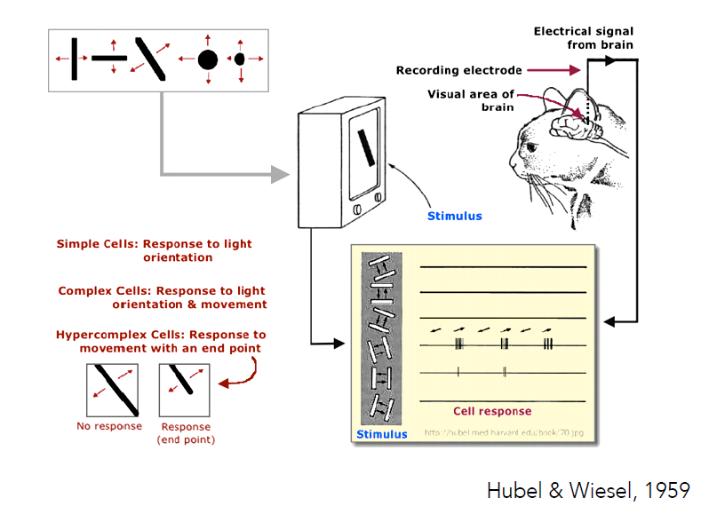

Slide 10
Learning Problem
Well-posed learning problem:
A computer program is said to learn from experience E with respect to some task T and some performance measure P, if its performance on T, as measured by P, improves with experience E.
By Tome Mitchell (1998)

Slide 11
Example
Your Email program watches which emails you do or do not mark as a spam and based on that learns how to better filter spam.
Task (T): Classifying the emails as spam or not
Experience (E): Watching you label emails as spam or not spam
Performance (P): The number of emails correctly classified as spam / not spam

Slide 12
Machine Learning Algorithms
Supervised Learning
Un-supervised Learning
Others: Reinforcement learning, recommender system
Where to apply which algorithms

Slide 13
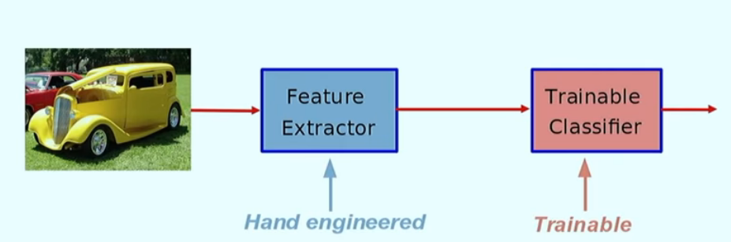
Conventional ML based Object Recognition

Slide 14
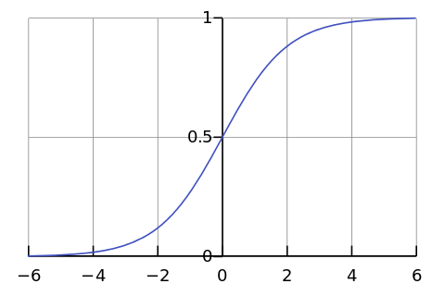

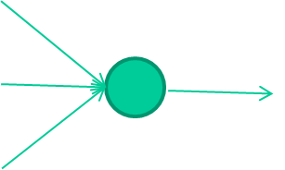
How Neural Network Works?
-0.06
W1
W2
f(x)
-2.5
W3
1.4

Slide 15
How Neural Network Works?
-0.06
2.7
-8.6
f(x)
-2.5
0.002
x = -0.06×2.7 + 2.5×8.6 + 1.4×0.002 = 21.34
1.4

Slide 16
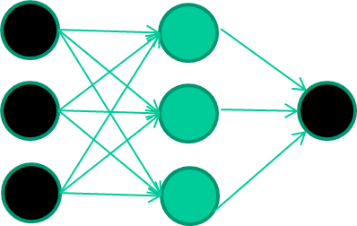
How Neural Network Works?
A dataset
Fields class
1.4 2.7 1.9 0
3.8 3.4 3.2 0
6.4 2.8 1.7 1
4.1 0.1 0.2 0
etc …

Slide 17
How Neural Network Works?
Training the neural network
Fields class
1.4 2.7 1.9 0
3.8 3.4 3.2 0
6.4 2.8 1.7 1
4.1 0.1 0.2 0
etc …

Slide 18
How Neural Network Works?
Initialise with random weights
Training data
Fields class
1.4 2.7 1.9 0
3.8 3.4 3.2 0
6.4 2.8 1.7 1
4.1 0.1 0.2 0
etc …

Slide 19
How Neural Network Works?
Training data
Fields class
1.4 2.7 1.9 0
3.8 3.4 3.2 0
6.4 2.8 1.7 1
4.1 0.1 0.2 0
etc …
1.4
2.7
1.9
Present a training pattern

Slide 20
How Neural Network Works?
Training data
Fields class
1.4 2.7 1.9 0
3.8 3.4 3.2 0
6.4 2.8 1.7 1
4.1 0.1 0.2 0
etc …
1.4
2.7 0.8
1.9
Feed it through to get output

Slide 21
How Neural Network Works?
Training data
Fields class
1.4 2.7 1.9 0
3.8 3.4 3.2 0
6.4 2.8 1.7 1
4.1 0.1 0.2 0
etc …
1.4
0.8
2.7
0
error 0.8
1.9
Compare with target output

Slide 22


How Neural Network Works?
Training data
Fields class
1.4 2.7 1.9 0
3.8 3.4 3.2 0
6.4 2.8 1.7 1
4.1 0.1 0.2 0
etc …
1.4
2.7 0.8
1.9 error 0.8
0
Adjust weights based on error

Slide 23
How Neural Network Works?
Training data
Fields class
1.4 2.7 1.9 0
3.8 3.4 3.2 0
6.4 2.8 1.7 1
4.1 0.1 0.2 0
etc …
6.4
2.8
1.7
Present a training pattern

Slide 24
How Neural Network Works?
Training data
Fields class
1.4 2.7 1.9 0
3.8 3.4 3.2 0
6.4 2.8 1.7 1
4.1 0.1 0.2 0
etc …
6.4
2.8 0.9
1.7
Feed it through to get output

Slide 25
How Neural Network Works?
Training data
Fields class
1.4 2.7 1.9 0
3.8 3.4 3.2 0
6.4 2.8 1.7 1
4.1 0.1 0.2 0
etc …
6.4
2.8 0.9
1.7 error -0.1
1
Compare with target output

Slide 26
How Neural Network Works?
Training data
Fields class
1.4 2.7 1.9 0
3.8 3.4 3.2 0
6.4 2.8 1.7 1
4.1 0.1 0.2 0
etc …
6.4
2.8 0.9
1.7 error -0.1
1
Adjust weights based on error

Slide 27
How Neural Network Works?
Training data
Fields class
1.4 2.7 1.9 0
3.8 3.4 3.2 0
6.4 2.8 1.7 1
4.1 0.1 0.2 0
etc …
6.4
2.8 0.9
1
1.7 error -0.1
And so on ….
Repeat this thousands, maybe millions of times – each time taking a random training instance, and making slight weight adjustments
Algorithms for weight adjustment are designed to make changes that will reduce the error

Slide 28
The decision boundary perspective…
Initial random weights

Slide 29
The decision boundary perspective…
Present a training instance / adjust the weights

Slide 30
The decision boundary perspective…
Present a training instance / adjust the weights

Slide 31
The decision boundary perspective…
Present a training instance / adjust the weights

Slide 32
The decision boundary perspective…
Present a training instance / adjust the weights

Slide 33
The decision boundary perspective…
Eventually ….

Slide 34
Introduction to Deep Learning

Slide 35
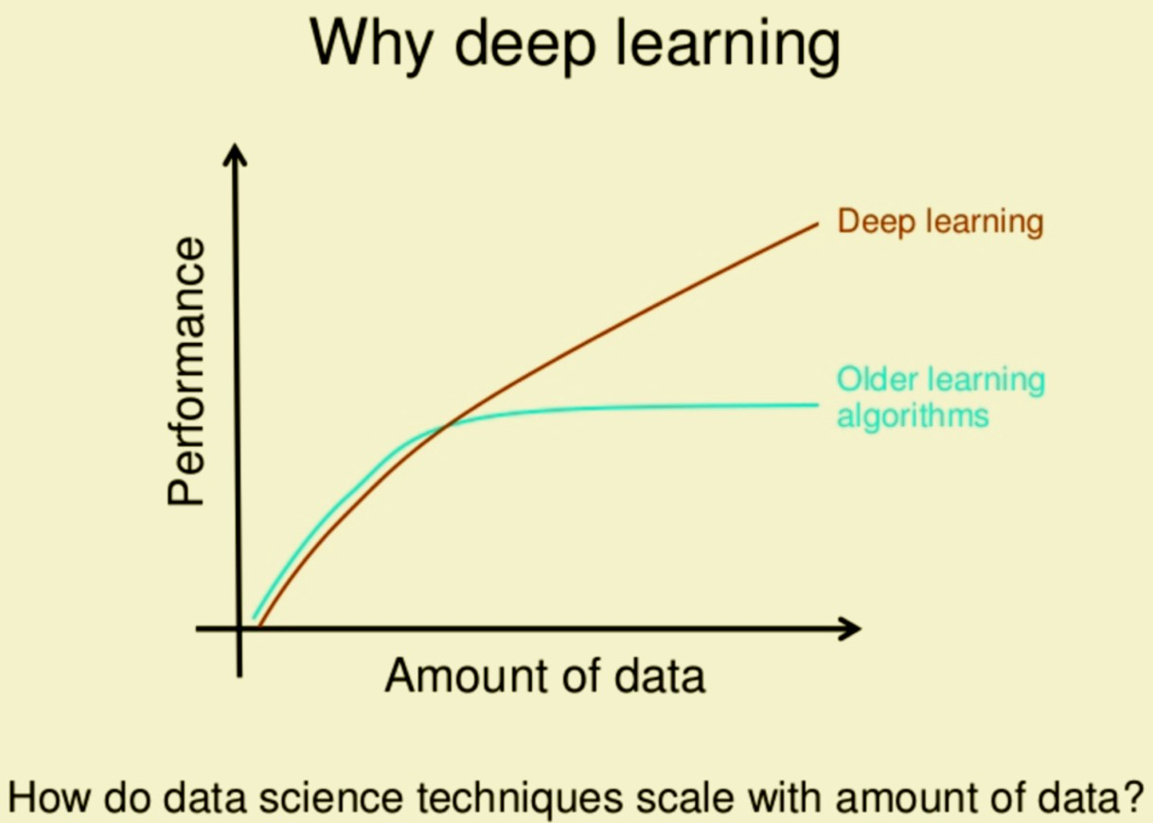
Problems with conventional machine learning
Manually designed features are often over-specified, incomplete and take a long time to design and validate
Less efficient to handle a large amount data with high order features
Source: Andrew Ng

Slide 36
Data
Computations (Hardware Resource)
Algorithm

Slide 37
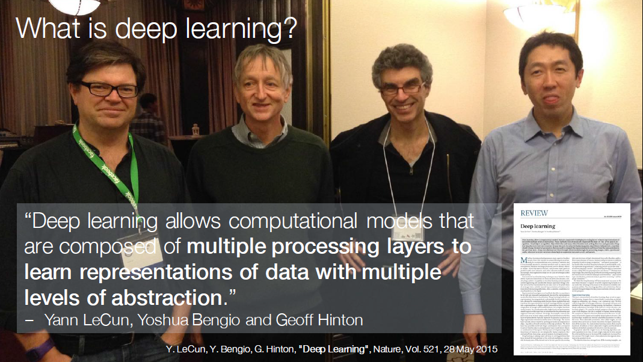

Slide 38
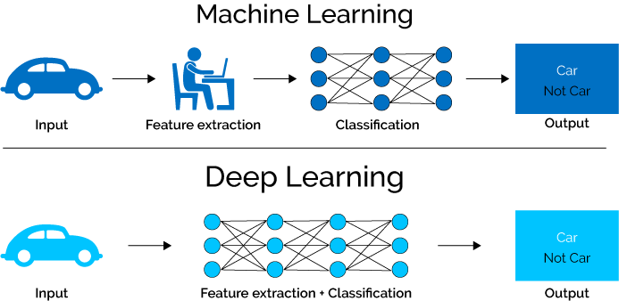
Machine Learning vs. Deep Learning
The key difference between deep learning and machine learning stems from the way data is presented to the system.
Machine learning algorithms almost always require structured data, whereas deep learning networks rely on layers of the ANN (artificial neural networks).
https://www.xenonstack.com/blog/static/public/uploads/media/machine-learning-vs-deep-learning.png

Slide 39
Deep Neural Network
Multiple Hidden Layers
Why Multiple Hidden Layers?

Slide 40
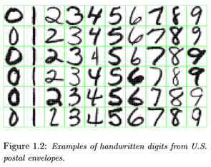
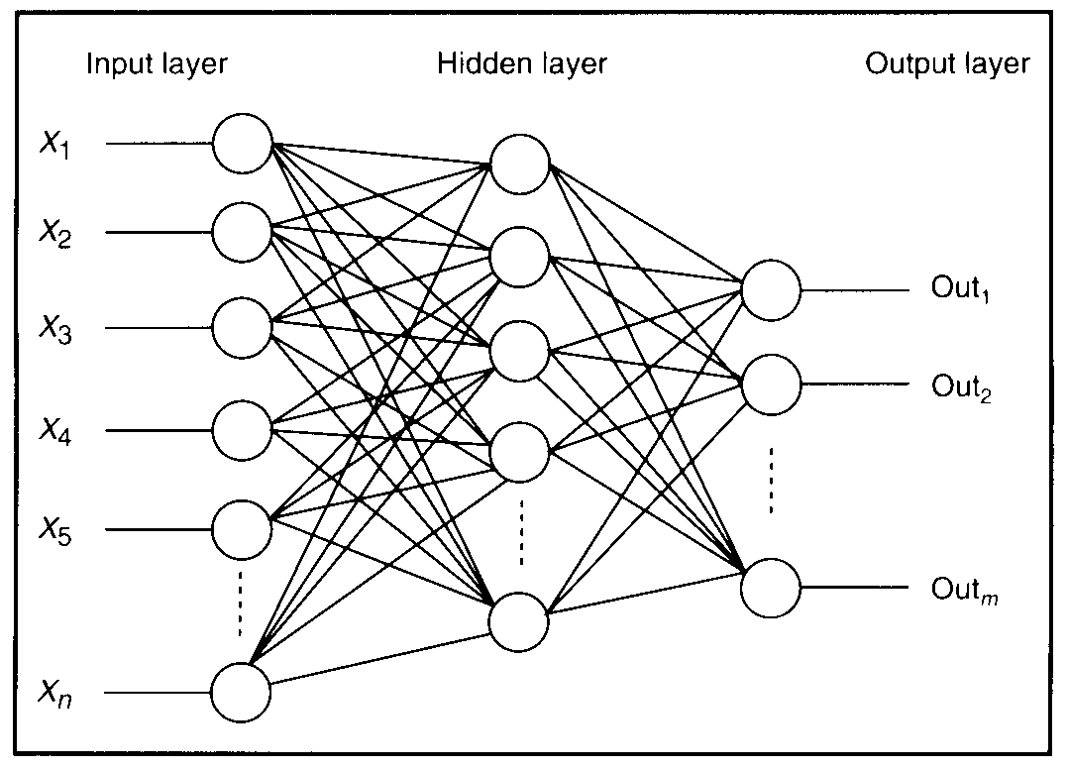
Feature Detectors

Slide 41
What is this unit doing?

Slide 42
Hidden layer units become self-organised feature detectors
1 5 10 15 20 25 …
…
1
strong +ve weight
low/zero weight
63

Slide 43
What does this unit detect?
1 5 10 15 20 25 …
…
1
strong +ve weight
low/zero weight
63

Slide 44
What does this unit detect?
1 5 10 15 20 25 …
…
1
strong +ve weight
low/zero weight
it will send strong signal for a horizontal
line in the top row, ignoring everywhere else
63

Slide 45
What does this unit detect?
1 5 10 15 20 25 …
…
1
strong +ve weight
low/zero weight
63

Slide 46
What does this unit detect?
1 5 10 15 20 25 …
…
1
strong +ve weight
low/zero weight
Strong signal for a dark area in the top left
corner
63

Slide 47
What features might you expect a good NN
to learn, when trained with data like this?

Slide 48
vertical lines
1
63

Slide 49
Horizontal lines
1
63

Slide 50
Small circles
1
63

Slide 51
Small circles
1
But what about position invariance ???
our example unit detectors were tied to
specific parts of the image
63

Slide 52
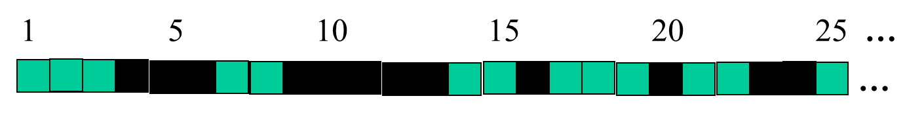
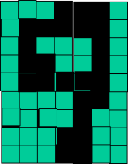
Successive layers can learn higher-level features …
detect lines in
Specific positions
etc …
Higher level detetors
( horizontal line,
“RHS vertical lune”
“upper loop”, etc…
etc …
v

Slide 53
Successive layers can learn higher-level features …
detect lines in
Specific positions
etc …
Higher level detetors
( horizontal line,
“RHS vertical lune”
“upper loop”, etc…
etc …
v
What does this unit detect?

Slide 54
So: multiple layers make sense

Slide 55
History of Neural Network

Slide 56
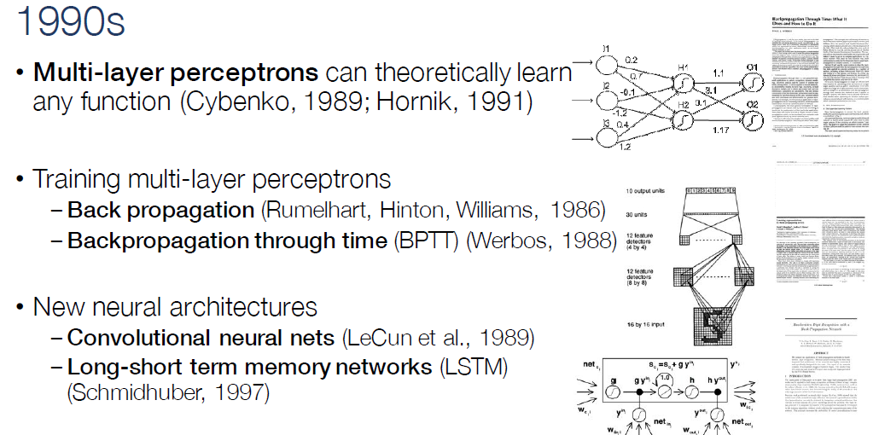

Slide 57
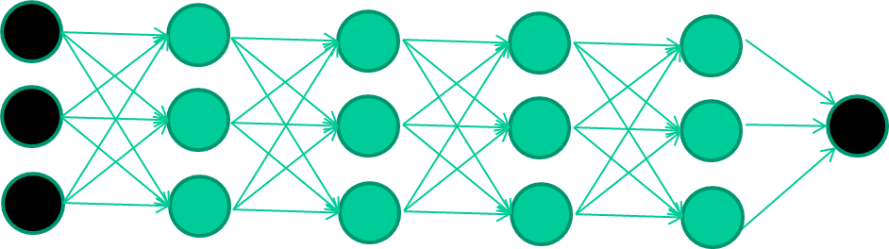
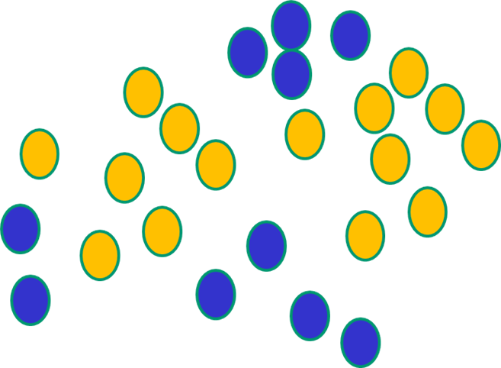

But, until very recently, our weight-learning algorithms simply did not work on multi-layer architectures

Slide 58
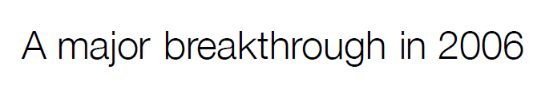

Slide 59
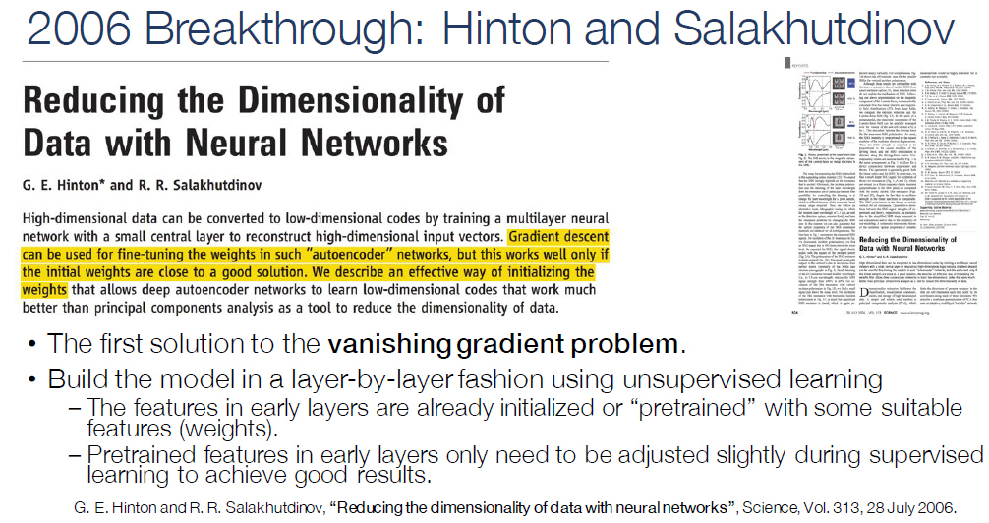

Slide 60
The new way to train multi-layer NNs…

Slide 61
The new way to train multi-layer NNs…
Train this layer first

Slide 62
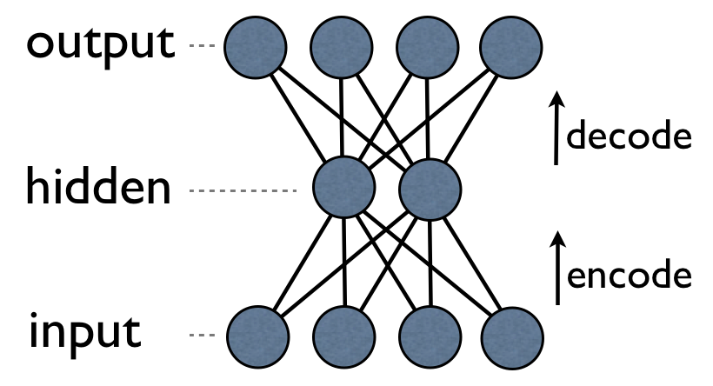
an auto-encoder is trained, with an absolutely standard weight-adjustment algorithm to reproduce the input

Slide 63
an auto-encoder is trained, with an absolutely standard weight-adjustment algorithm to reproduce the input
By making this happen with (many) fewer units than the inputs, this forces the ‘hidden layer’ units to become good feature detectors

Slide 64
The new way to train multi-layer NNs…
Train this layer first
then this layer

Slide 65
The new way to train multi-layer NNs…
Train this layer first
then this layer
then this layer

Slide 66
The new way to train multi-layer NNs…
Train this layer first
then this layer
then this layer
then this layer

Slide 67
The new way to train multi-layer NNs…
Train this layer first
then this layer
then this layer
then this layer
finally this layer

Slide 68
Thank you
&
Questions

